Slide 1

Image Scraping and Classification Project

Slide 2
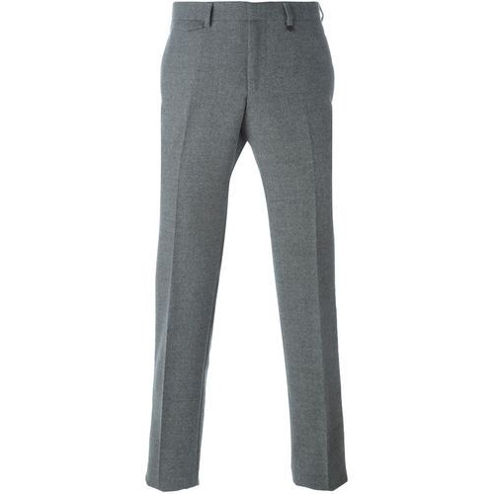
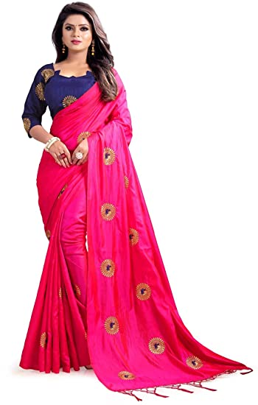
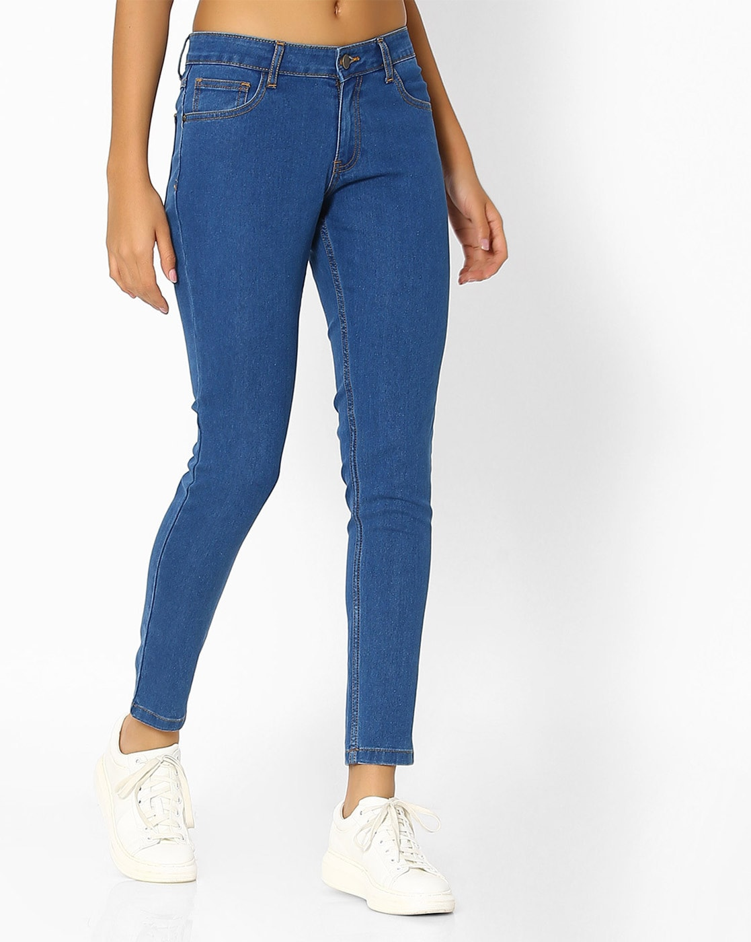
Problem Statement
Building a model which can classify between trousers, sarees and Jeans

Slide 3
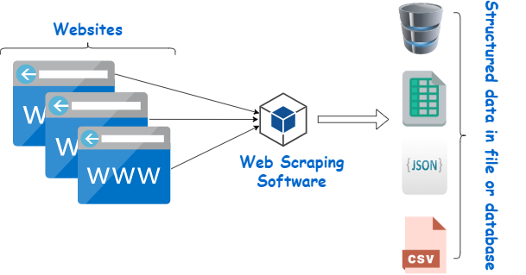
Step 1: Scrapping data from Amazon and flipkart website
Amazon website data scrapped is the training data
Flipkart website scrapped is the test data

Slide 4
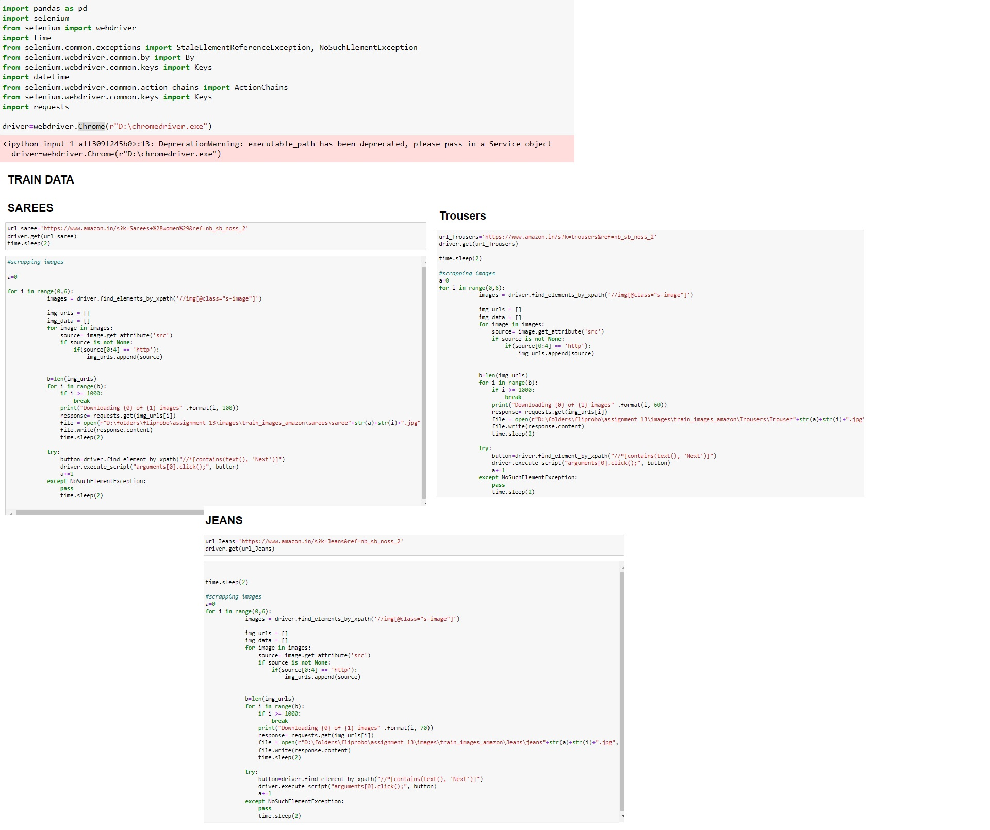

Slide 5
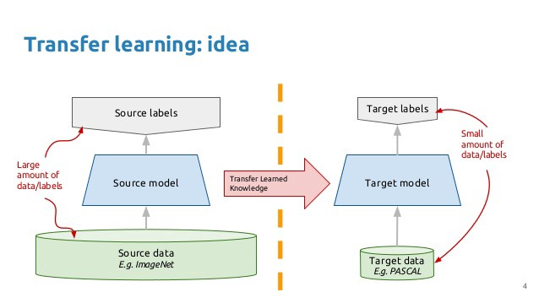
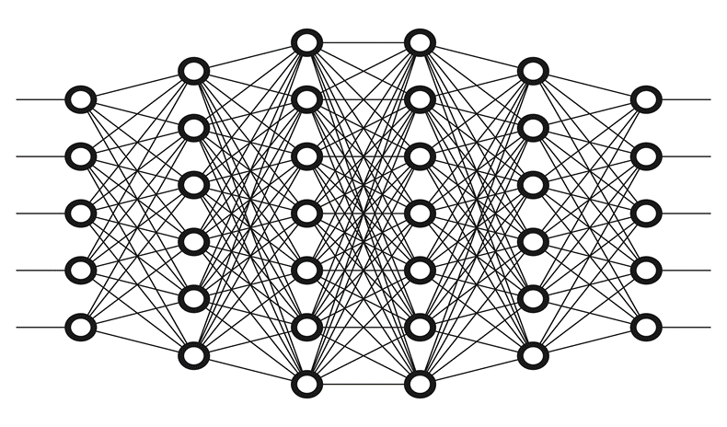
Step 2: Model building through transfer learning

Slide 6
Loading the libraries
Loading the data csv file
Loading the model with no last layer
Not letting the layers of the transfer models train and
The same weights need to be used
The output from the tranfer model is flattened
Locating the folders of the scrapped images

Slide 7
The folder of images is appended as Dense layer to the flattened Transfer model. This is passed to the Softmax activation function
Model is created with the backpropogation occurring
Compiling the model with the optimum optimiser, Loss calculation method and metrics used to understand the accuracy of prediction
image augmentation techniques is used to increase the size of the data but making sure the quality of data is not compromised
Applying the trained model on the test data and finding the accuracy

Slide 8
Loading the data csv file
Loading the libraries

Slide 9
Loading the model with no last layer
Not letting the layers of the transfer models train and
The same weights need to be used

Slide 10
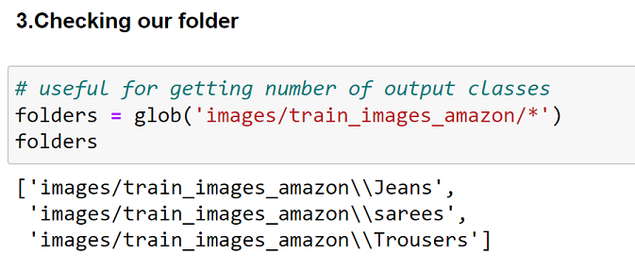
Locating the folders
The output from the tranfer model is flattened

Slide 11
Model is created with the backpropogation occurring
The folder of images is appended as Dense layer to the flattened Transfer model. This is passed to the Softmax activation function

Slide 12
Compiling the model with the optimim optimiser,Loss calculation method and metrics used to understand the accuracy of prediction
image augmentation techniques is used to increase the size of the data but making sure the quality of data is not compromised

Slide 13
Applying the trained model on the test data and finding the accuracy

Slide 14
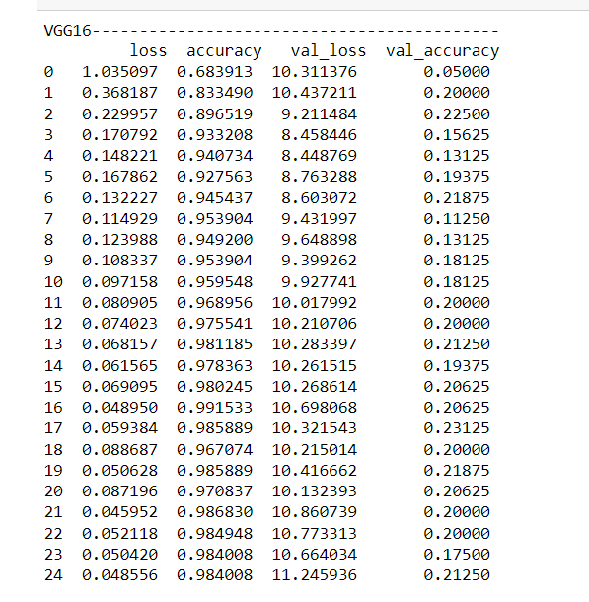
Step 3:Choosing the best model and saving it
Best model is vgg 16 with 16 epochs

Slide 15
Technology Used for the Project
Hardware technology being used.
RAM : 8 GB
CPU :Intel® Core™ i7-10510U CPU @ 1.80GHz
GPU: NVIDA-Cuda , performed in tf_gpu_env enviroment
Software technology being used.
Programming language : Python
Distribution : Anaconda Navigator
Browser based language shell : Jupyter Notebook
Libraries/Packages specifically being used.
Pandas , NumPy, matplotlib, Tensorflow, keras

Slide 16
Identified Transfer learning techniques for classification
VGG16
VGG19
ResNet50

Slide 17
Saving the model

Slide 18
THANK YOU Have a nice day

